Slide 1
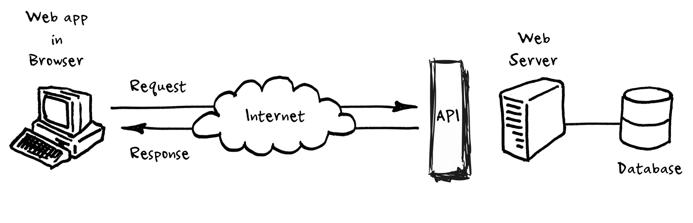
Databases and APIs
A match made in heaven

Slide 2
What is an API?
Stands for “Application Programming Interface.”
Modern APIs adhere to standards (typically HTTP and REST) making them developer-friendly, easily accessible and broadly understood
Designed for consumption for specific audiences (e.g., mobile developers)
APIs are documented, and they are versioned in a way that users can have certain expectations of its maintenance and lifecycle
Notes:
Think of an API like a menu in a restaurant. The menu provides a list of dishes you can order, along with a description of each dish. When you specify what menu items you want, the restaurant’s kitchen does the work and provides you with some finished dishes. You don’t know exactly how the restaurant prepares that food, and you don’t really need to.
Similarly, an API lists a bunch of operations that developers can use, along with a description of what they do. The developer doesn’t necessarily need to know how, for example, an operating system builds and presents a “Save As” dialog box. They just need to know that it’s available for use in their app.
This isn’t a perfect metaphor, as developers may have to provide their own data to the API to get the results, so perhaps it’s more like a fancy restaurant where you can provide some of your own ingredients the kitchen will work with.
But it’s broadly accurate. APIs allow developers to save time by taking advantage of a platform’s implementation to do the nitty-gritty work. This helps reduce the amount of code developers need to create, and also helps create more consistency across apps for the same platform. APIs can control access to hardware and software resources.
What Is an API? (howtogeek.com)

Slide 3
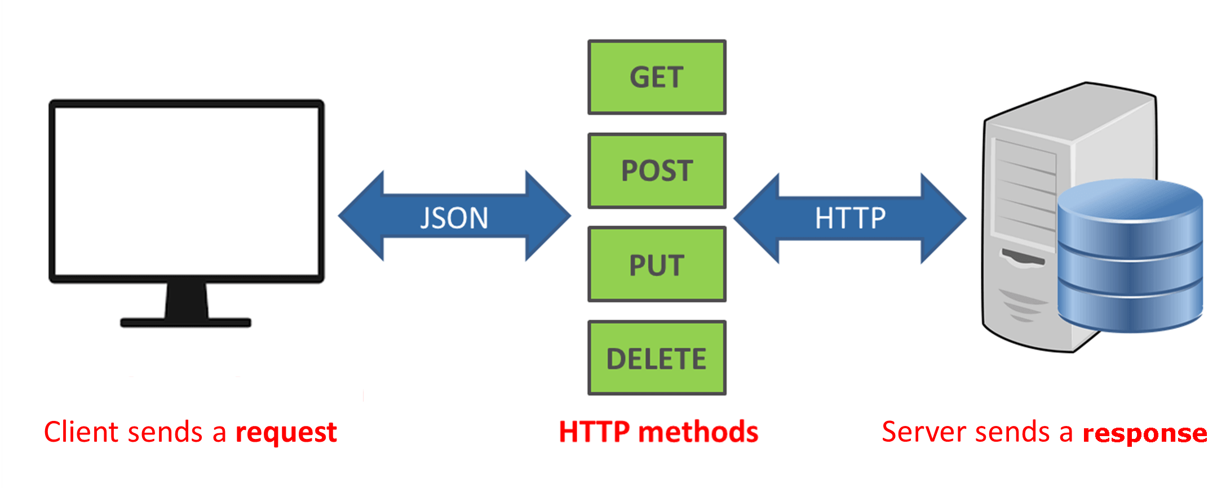
What is a REST API?
Notes:
The term REST stands for REpresentational State Transfer. It is an architectural style that defines a set of rules in order to create Web Services.
The architectural style of REST helps in leveraging the lesser use of bandwidth to make an application more suitable for the internet. It is often regarded as the “language of the internet” and is completely based on the resources.
Create -> Post
Retrieve -> Get
Update -> Put
Delete -> Delete

Slide 4
What is Entity Framework?
Entity Framework (EF) is an object-relational mapper that enables .NET developers to work with relational data using domain-specific objects
It eliminates the need for most of the data-access code that developers usually need to write.
Notes:
Prior to .NET 3.5, we (developers) often used to write ADO.NET code or Enterprise Data Access Block to save or retrieve application data from the underlying database. We used to open a connection to the database, create a DataSet to fetch or submit the data to the database, convert data from the DataSet to .NET objects or vice-versa to apply business rules. This was a cumbersome and error prone process. Microsoft has provided a framework called "Entity Framework" to automate all these database related activities for your application.
Entity Framework is an open-source ORM framework for .NET applications supported by Microsoft. It enables developers to work with data using objects of domain specific classes without focusing on the underlying database tables and columns where this data is stored. With the Entity Framework, developers can work at a higher level of abstraction when they deal with data, and can create and maintain data-oriented applications with less code compared with traditional applications.

Slide 5
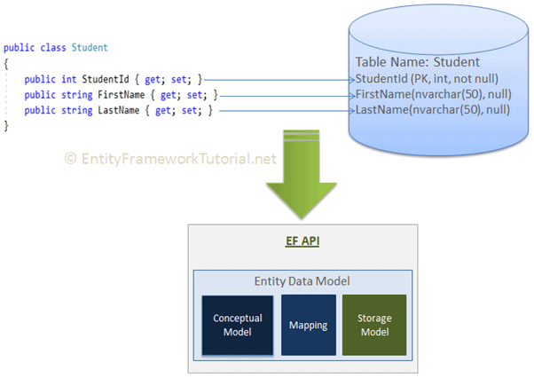
.NET Class to Table

Slide 6
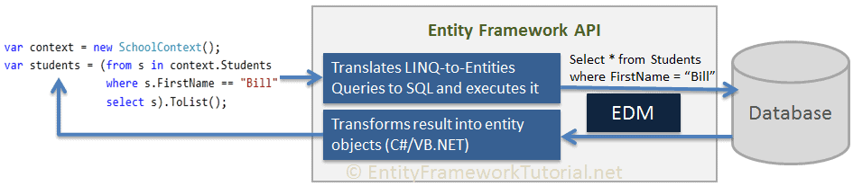
LinQ to SQL

Slide 7
Demo
Notes:
Generating a model from an existing database | Learn Entity Framework Core
Code First to an Existing Database - EF6 | Microsoft Docs
nastassiar/Entity-Framework-Test-applications: Testing out Entity Framework with a console app and ASP.NET Web App (github.com)

Slide 8
The Tools I used
.Net Framework 4.7.2
ASP.Net/Console App
Azure SQL
Visual Studio Community 2019
Entity Framework 6
Postman

Slide 9

Putting it all together
To have your data/database be of value to your consumers it needs to be accessible
APIs can be a point of entry for your data consumers and contributors
APIs can also help you protect your data/database by creating a layer in between and giving the developer a place to build in rules and access policies

Slide 10
Questions?

